Slide 1
Linux kernel rootkit detection challenges
It’s easy, too easy…

Slide 2
What we know to do well
Static/Code (comparison)
Disk vs Memory when possible
Check specifically in places in the kernel we know

Slide 3
There are 1000 more ways right??
Time to show that

Slide 4
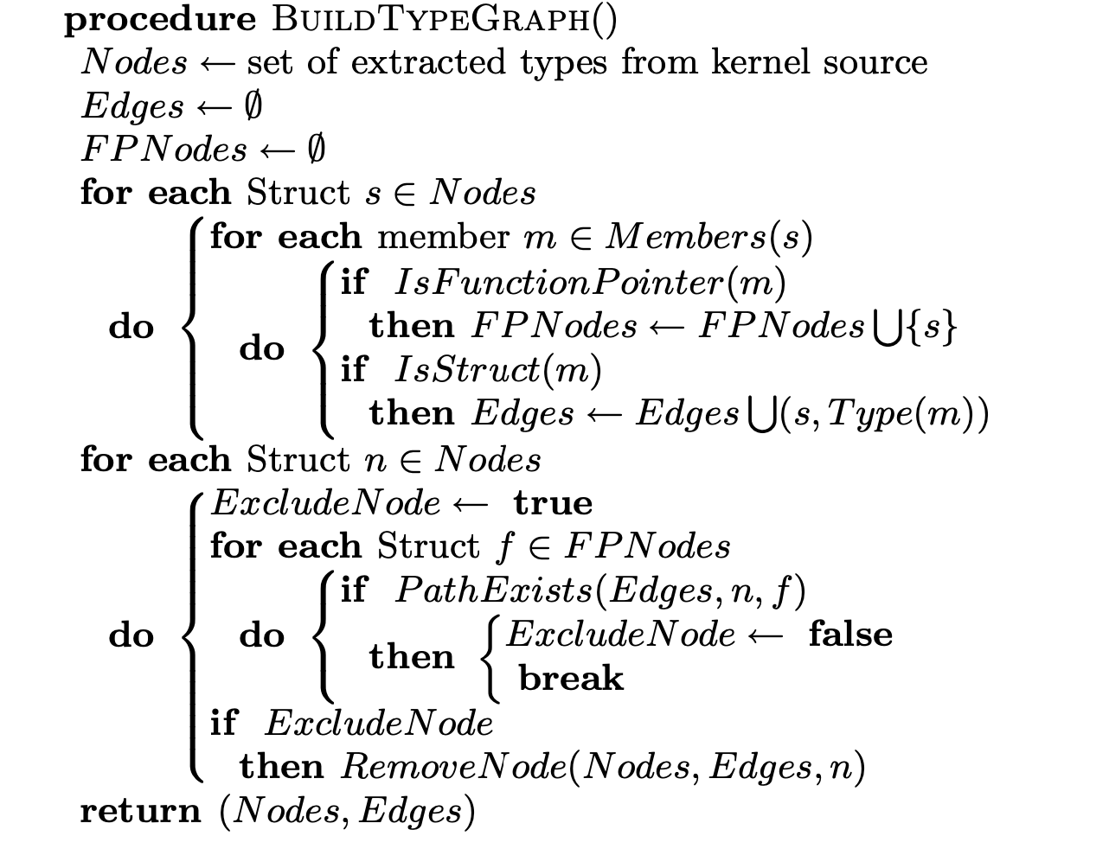
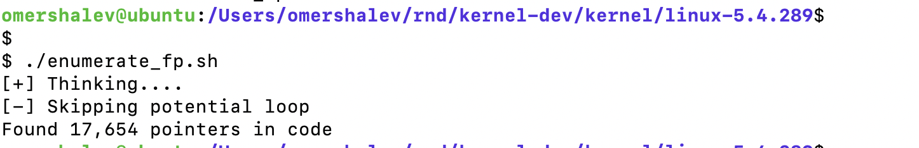
18,000 kernel function pointers in data areas
credit: https://www.cs.umd.edu/~mwh/papers/sbcfi.pdf

Slide 5
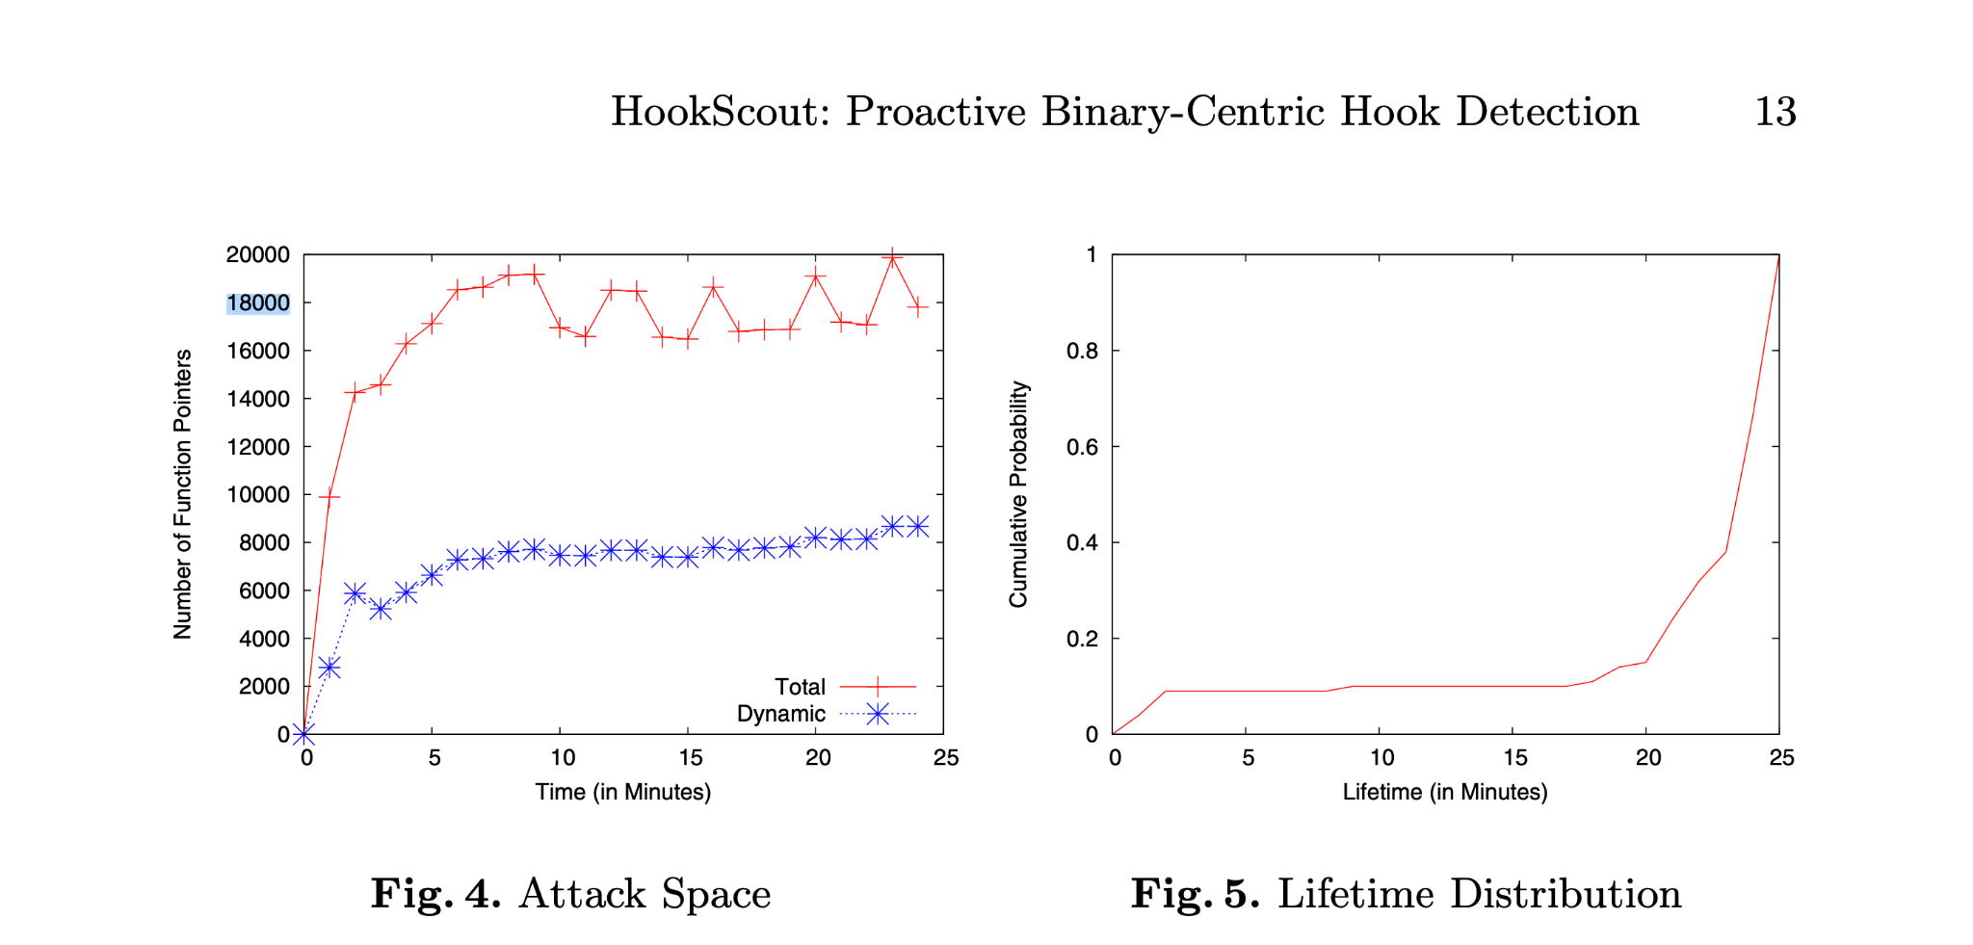
I am not the only one - In Windows (Xp)
credit: http://bitblaze.cs.berkeley.edu/papers/hookscout-dimva10.pdf

Slide 6
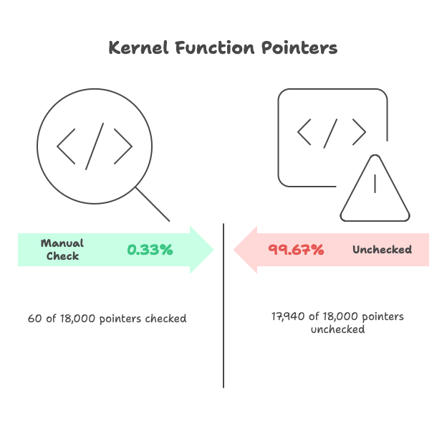

Slide 7
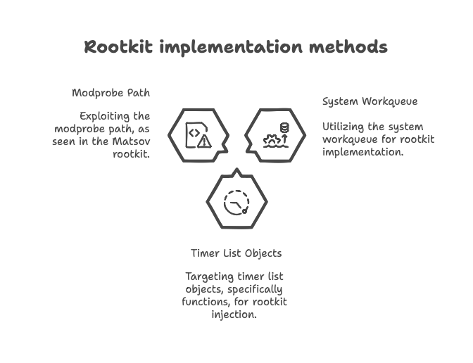
Small POC
Ex rookit for matsov

Slide 8
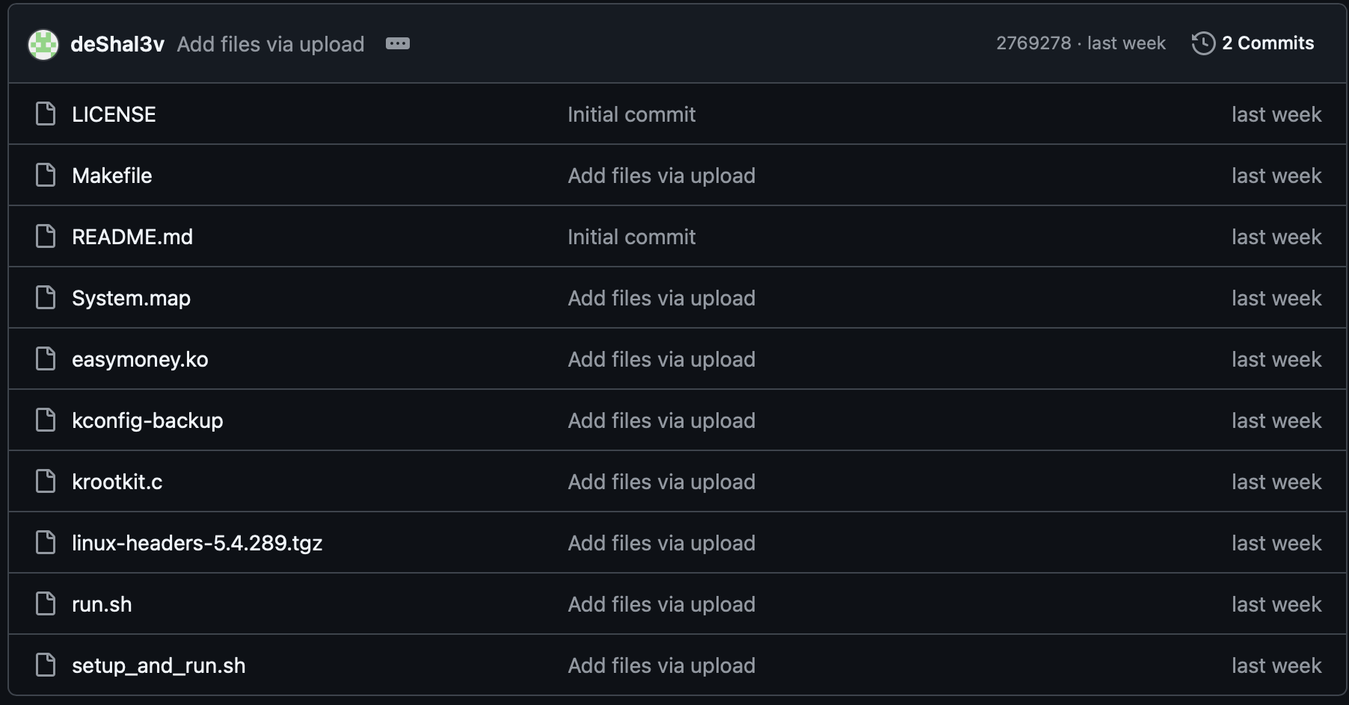
Small POC

Slide 9
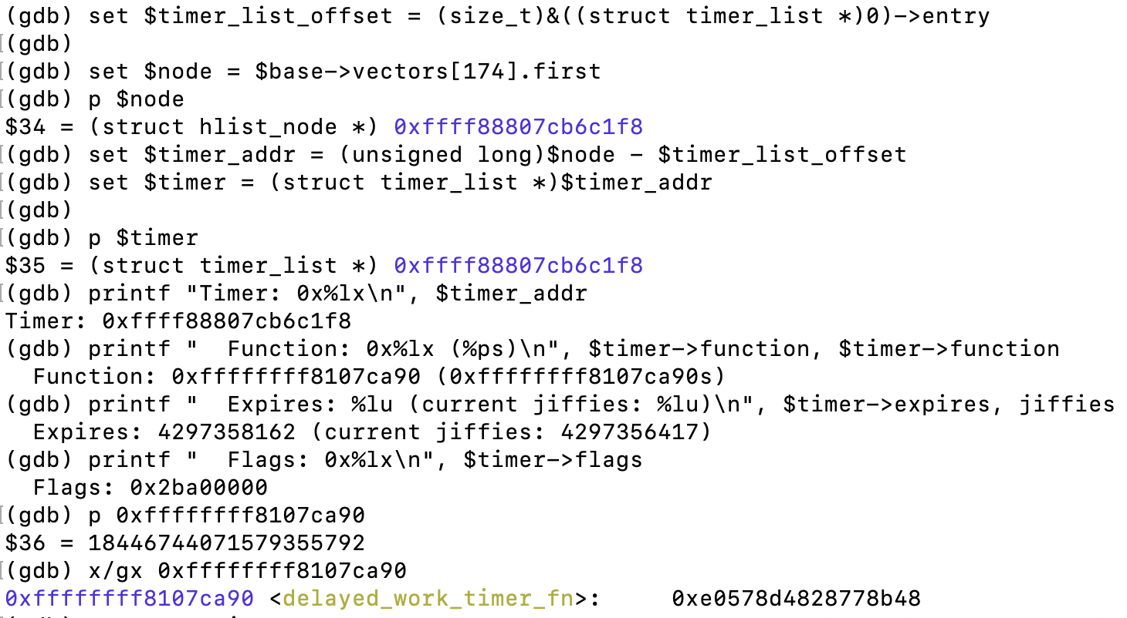

Slide 10
The problem of 7753 (not only)
Overfitting
DKOM: completely blind to unresearched mechanisms
Not enough resource to map significantly more kernel areas for research.

Slide 11
The Problem
Every Kernel mechanism requires dedicated ‘research’ that can be done by only few.
Not Doing research
not enough resources
Overfitting
ללכת בלי ולהרגיש עם

Slide 12
Kernel Rootkit Detection: Classification and Taxonomy
7753 knows to
Signature-Based Detection
Identifies rootkits using known malware signatures, hash values, code patterns, or tampered kernel tables.
Fast, but easily evaded with code changes or advanced hiding.
Cross-View-Based Detection
Compares high-level OS outputs (e.g., process and module listings) with low-level memory scans to spot discrepancies from rootkit hiding methods (.
Often used in forensic analysis and live memory tools.
DKOM (60/18000)
Out of reach
Behavior-Based Detection
Monitors kernel for suspicious activities: abnormal memory accesses, unauthorized function hooks, device driver anomalies, hidden files/processes, and direct data structure tampering.
Effective against stealth techniques, but can be noisy or subject to false positives.
Integrity-Based Detection
Checks and enforces kernel code/data integrity using hashes, write-protection, function pointer validation, and hardware policies.
Robust, but may introduce overhead and not cover all attack surfaces.
External Hardware-Based Detection
Uses coprocessors or isolated hardware modules to monitor kernel state and memory from outside the OS.
Highly resistant to tampering, but incurs extra cost and complexity.
Learning-Based Detection (AI/ML)
Utilizes machine and deep learning for profiling behavior, anomaly detection, and feature learning from kernel activity and memory/state data.
Adaptable to new threats, but depends on good data, features, and careful training.

Slide 13

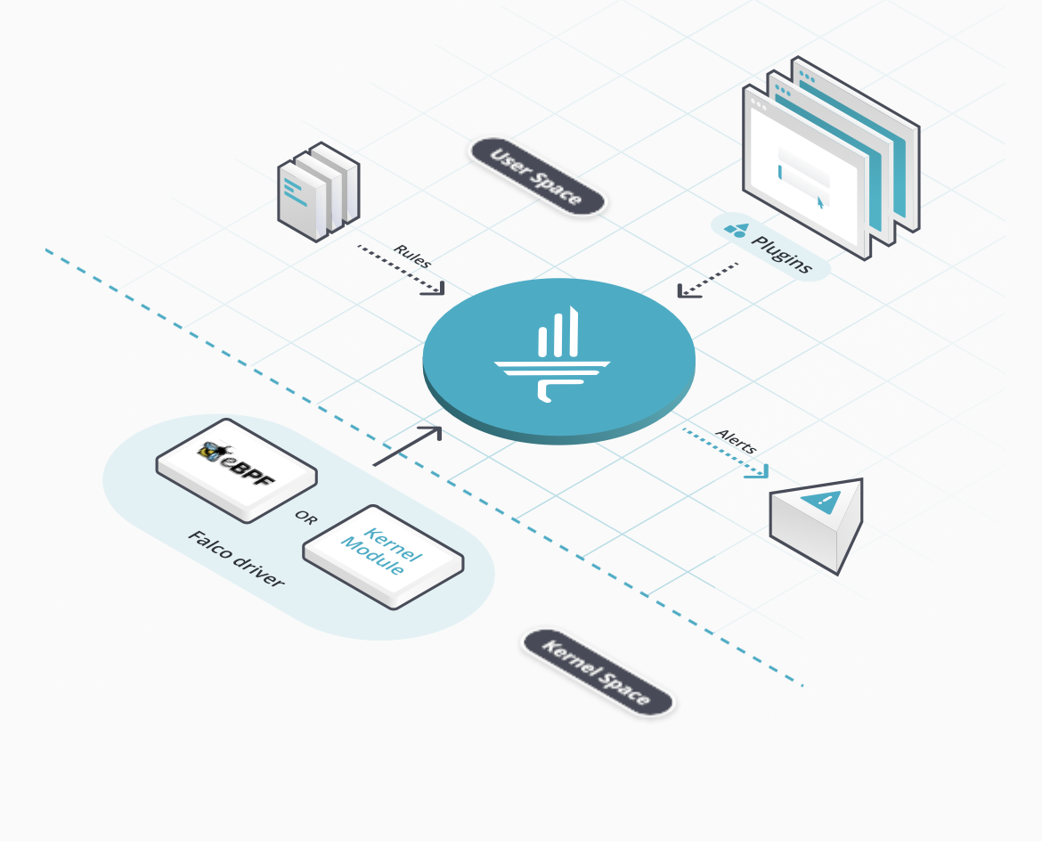

Areas we should get into
DKOM (direct kernel object manipulation) - finding a smarter approach
Emulation and Intervention (hypervisor based, emulation, eBPF)
Some outsource and open source:
i.e (how to replace Seekle tomorrow)

Slide 14
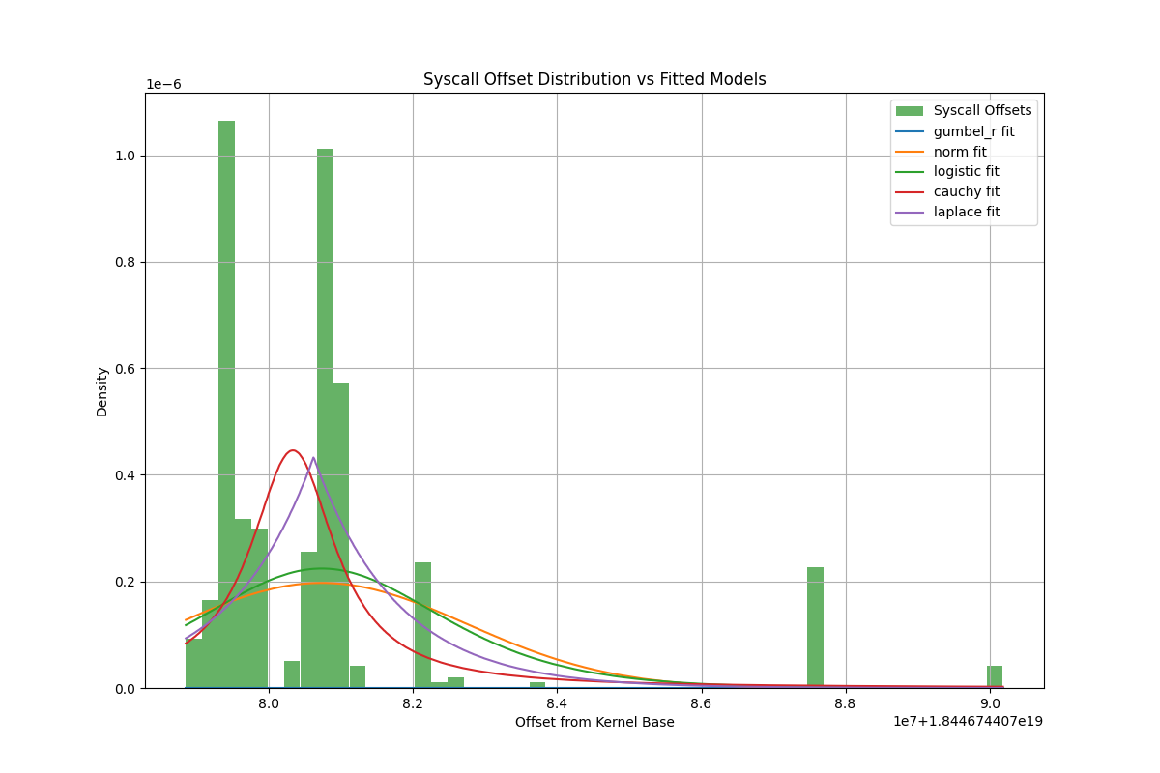
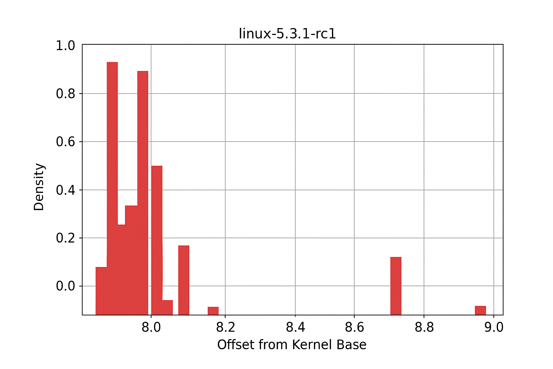
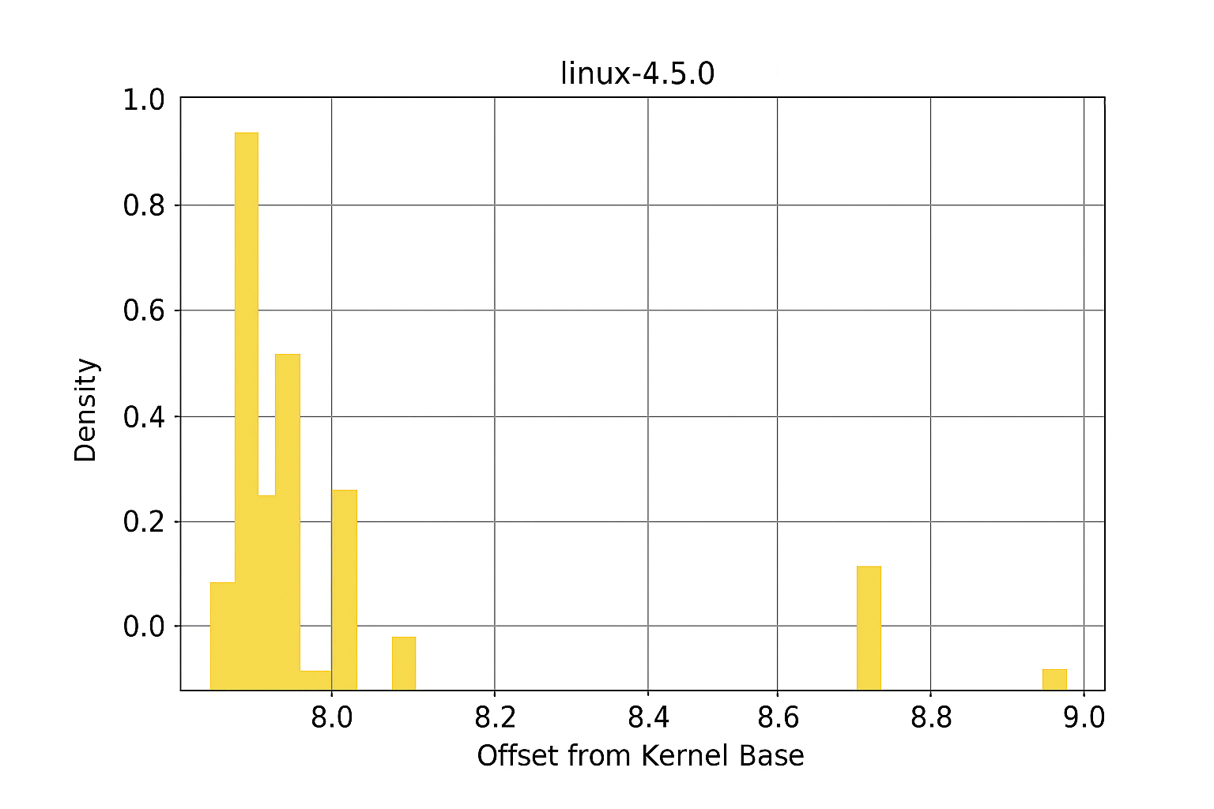
Some experiments

Slide 15
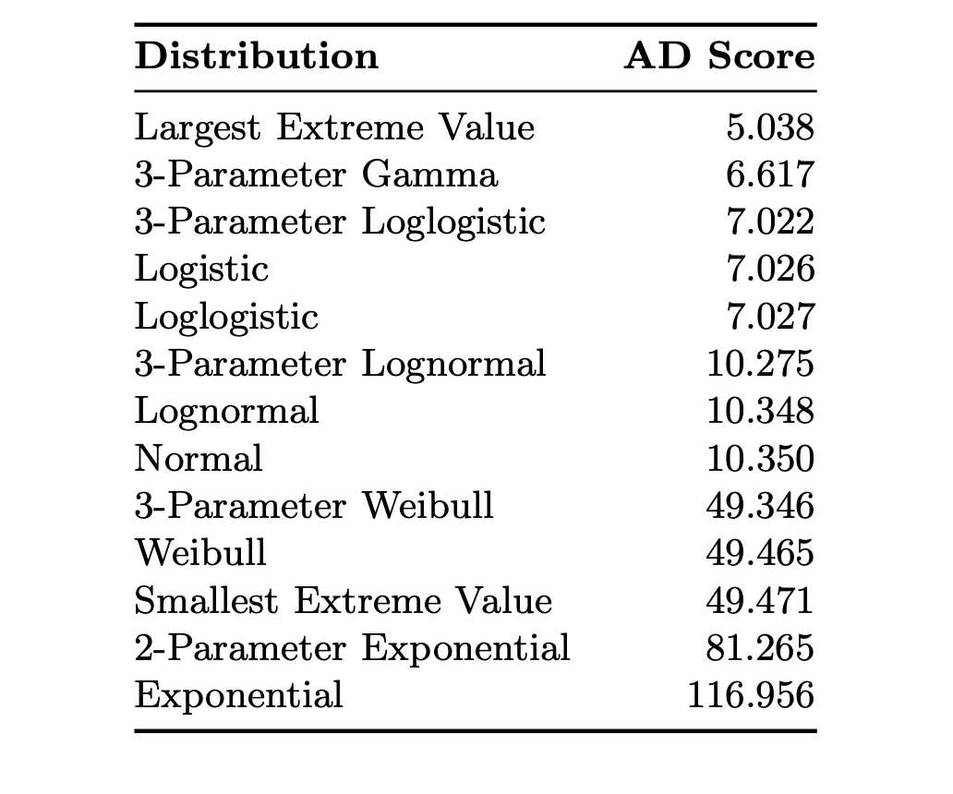
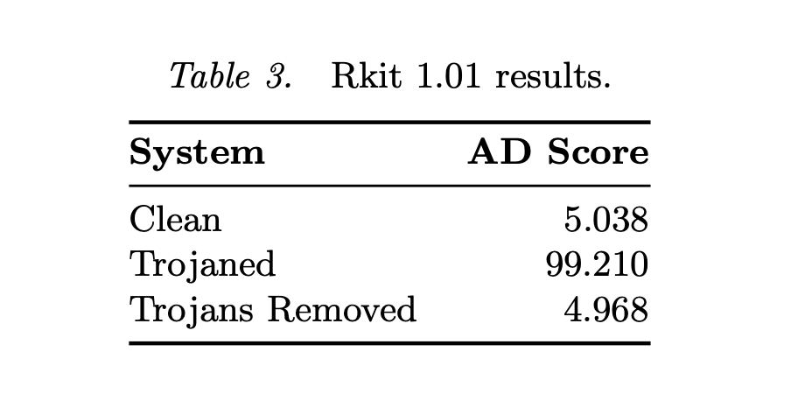
Some experiments
credit: https://dl.ifip.org/db/conf/ifip11-9/df2007/WamplerG07.pdf

Slide 16
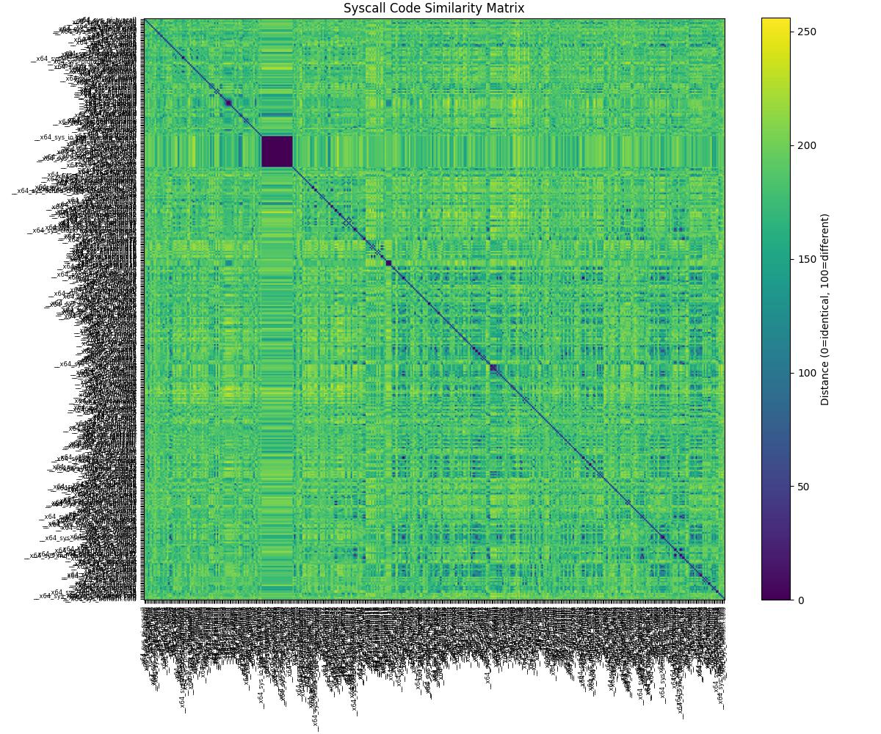

Slide 17
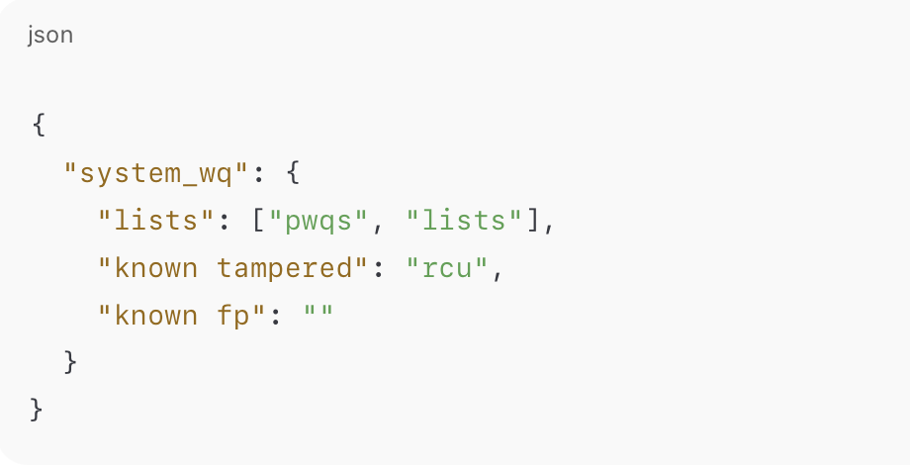
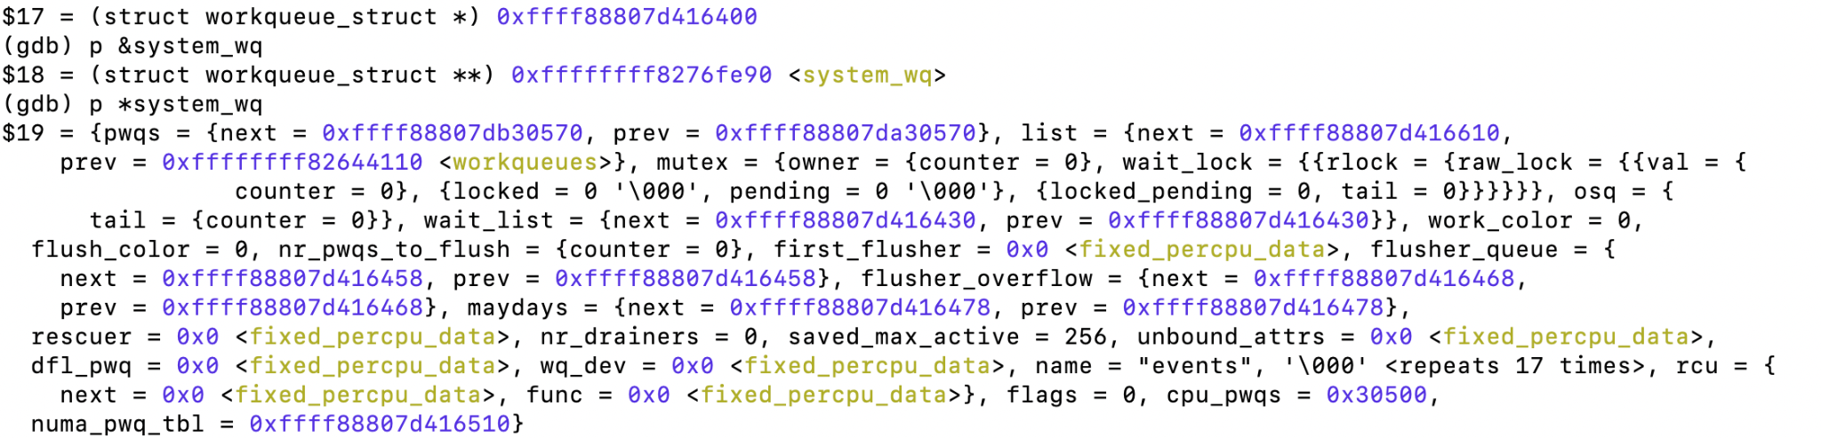
How will it look

Slide 18
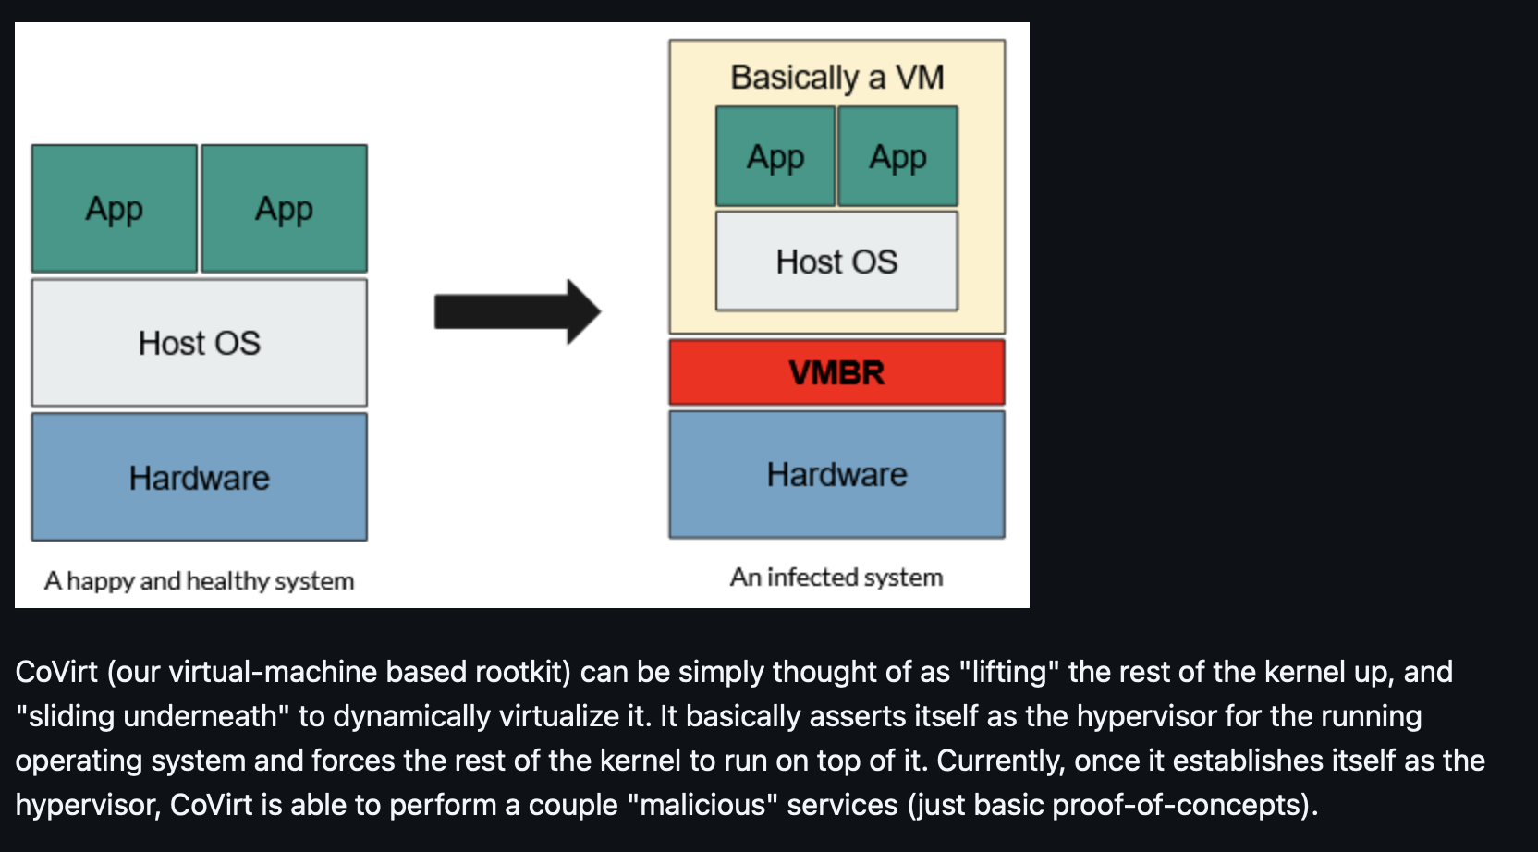

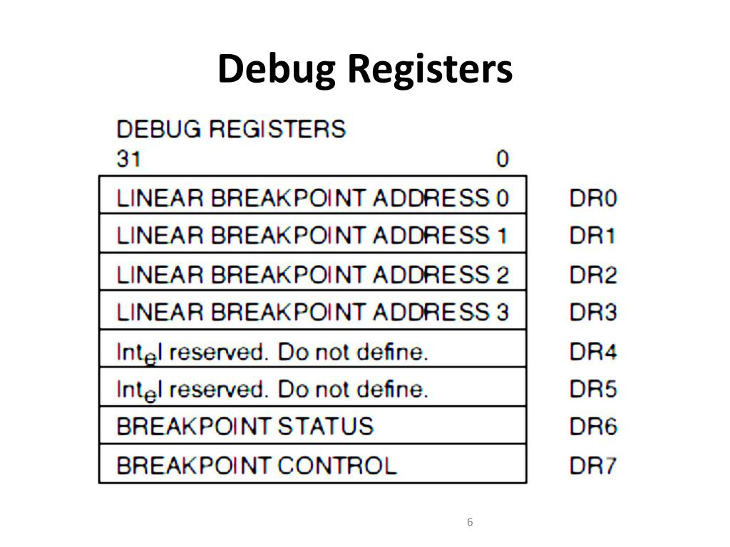
Motivation and tools

Slide 19



Action Items
complete research - learning based
1. call stack modelling using ePBF trace demo and learning based method
2. smart kernel specific data fuzzy hashing with user input
complete reaserach - monitor based
3. machine lifting - both amd and intel and monitoring
4. Debug registers access monitoring
5. eBPF memory inspection in realtime
6. emulation based for kernel (qemu/using kexec maybe)
שלושה חודשים פלוס במשרד סגולה…
36h PoC for PoC at home for each
48h PoC at home:
find best lead
implement it

Slide 20
What we have done already
Market research
Knows exactly what exists out there (not so much in companies IP)
Read ~15 research papers fromrecent years.
Putting the finger on the problem.
Demonstrating two kernel rootkits using this understanding. (that we didnt find…)
Starting to play with the data and finding stuff. HDBSCAN on syscalls, ext4_operations.
Writing eBPF probing mechanism to take kernel traces in realtime - almost done
חודשיים במשרד, לקח יום עבודה ברוטו (בבית…)

Slide 21

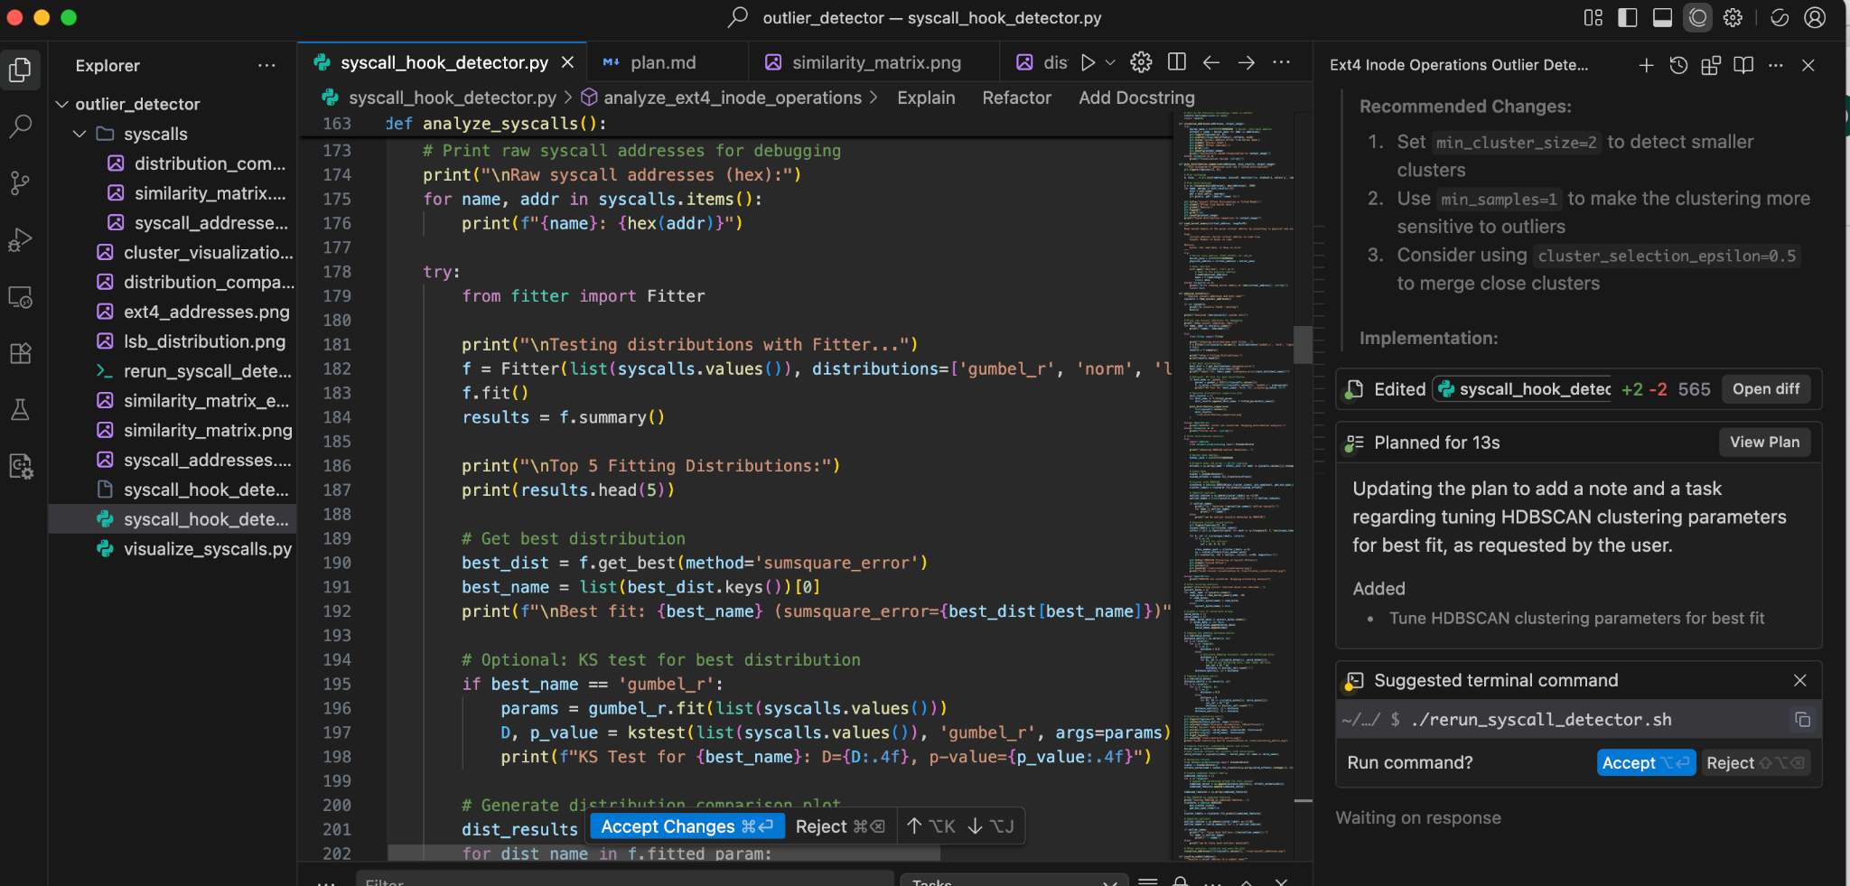
Challenges for me (i.e Help me to help you )

Slide 22


Challenges for me (i.e Help me to help you )
2.

Slide 23
Opportunities (Why Now)
Semi free - looking for new challenge after Hexagon
The rise and availability of llms/statistical learning frameworks and tools
Got the best training in the IDF - let me use this….
Academic background
The new ai tools let me cover up on my weaknesses that usually hold me back
I am very slow - windsurf and cursor help a lot to mitigate and make it less noticeable in my work
No need to do dev alone anymore - new llms are great. By choosing and training the right ones you can get very good results for linux based coding.

Slide 24
Ideas - what can we do
Work from home some of the day - i.e arriving late and utilizing the morning.
Work from other facility
Keep the spark - hackathon based and freedom.

